Slide 1
INTRODUCTION TO PYTHON

Slide 2
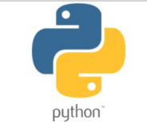
WHAT IS PYTHON LANGUAGE?
Python is a language that can be understood by computers and machines.
Python is an easy to learn, powerful programming language.
Python is an object-oriented programming language.
Python has a lot of libraries for scientific computing.
Python’s syntax is similar to English language.
Python is dynamically typed.
Python is an interpreted language.
Python was created by Guido van Rossum in 1991.
Python is open source language.

Slide 3
ADVANTAGES OF PYTHON
Python has fewer lines of code as compared to other programming languages.
Python’s syntax is similar to English language.
Python is easy to learn and simple to use.
Python is an interpreted language. Hence, no compilation or linking is necessary.
Python is dynamically typed.
Python is open source language.
Python works on different platforms (Windows, Mac, Linux, Raspberry Pi, etc.)

Slide 4
APPLICATIONS OF PYTHON
It is used for:
Software development
Web development
Machine learning
Data science
Big data analytics
Deep learning
Natural language processing

Slide 5
PROGRAMMING WITH PYTHON

Slide 6
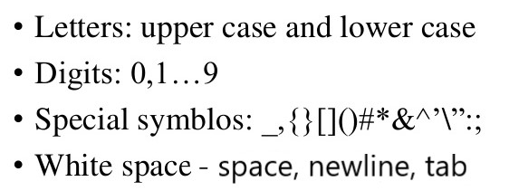
PYTHON CHARACTER SET
Character set is a set of valid characters that a language can recognize. Python supports the following characters:
Newline - \n
Tab - \t

Slide 7
TOKENS
The smallest individual unit in a program is called a token or lexical unit.
The types of tokens are:
Keywords
Identifiers(names)
Literals
Operators
Punctuators

Slide 8
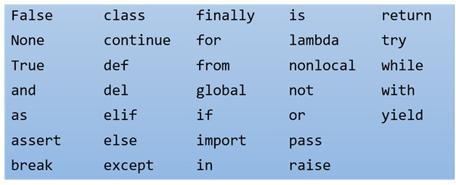
KEYWORDS
A word having special meaning reserved by a programming language is called a keyword.
These words must not be used as identifier names.
All the Python keywords contain lowercase letters only.

Slide 9
IDENTIFIERS (NAMES)
Names of variables are called identifiers.
NAMING CONVENTIONS
Identifiers can consist of letters (A-Z and a-z) and numbers(0-9) and only one special symbol is allowed (underscore _).
An identifier cannot start with a number. It cannot contain any other special character other than underscore.
Identifiers are case-sensitive.
Identifiers must not be keywords.

Slide 10
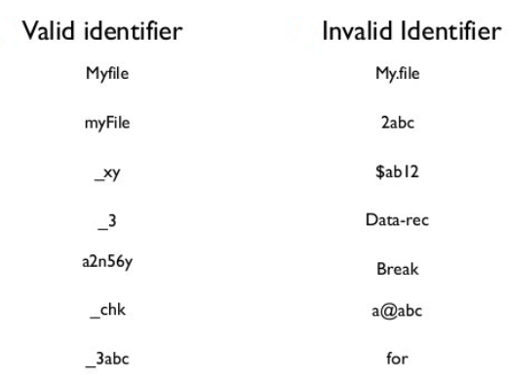
VALID AND INVALID IDENTIFIERS

Slide 11
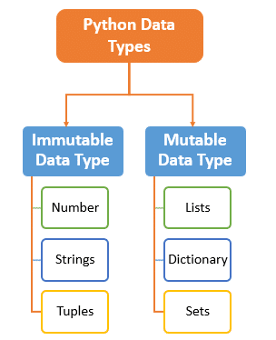
LITERALS
Literals are data items that have a fixed value.
The types of literals in Python are:
Numeric literals
String literals
Boolean literals
Special literal None
Literal collection

Slide 12
NUMERIC LITERALS
The three types of numeric literals are:
int (integers): They are positive or negative whole numbers with no decimal point.
float (floating point real values) : They represent real numbers and are written with a decimal point representing the fractional parts.
complex (complex numbers) : They are of the form a + bj, where a and b are floats and J (or j) represents the square root of -1 (which is an imaginary number). The real part of the number is a, and the imaginary part is b.

Slide 13
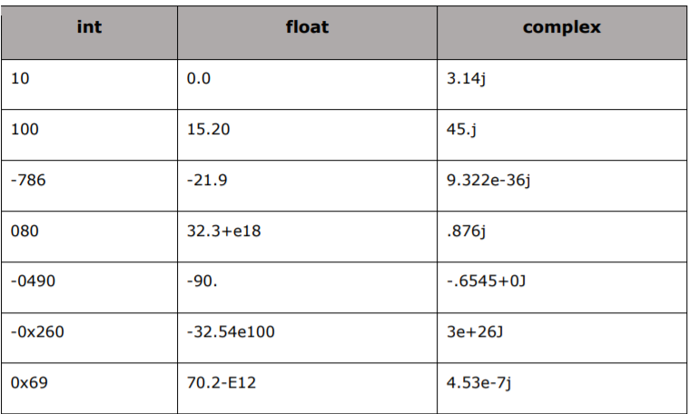
NUMERIC LITERALS
EXAMPLES

Slide 14
STRING LITERALS
String is an ordered sequence of letters/characters.
They are enclosed in single(‘ ’) or double(“ ”) quotes. The quotes are not part of string.
They can have any character or sign, including space in them.
These are immutable data types.
EXAMPLES
Single Line Strings: “a”, ‘Hello!’, “How are you?”
Multi-line Strings: “Hello\
world!”
Use Backslash(\) for Multi-line strings.

Slide 15
BOOLEAN LITERALS
It's used to represent the truth value of an expression.
A Boolean literal is used to represent one of the two Boolean values:
True
False

Slide 16
SPECIAL LITERAL None
None is used to define a null value.
It is not the same as an empty string, False, or a zero.
Assigning a value of None to a variable is one way to reset it to its original, empty state.

Slide 17
LITERAL COLLECTIONS
Python provides the four types of literal collections:
List literals
Tuple literals
Dictionary literals
Set literals

Slide 18
OPERATORS
Operators are tokens that allow computation/operation on variables.
The variables on which operation is being done are called operands.
There are two main types of operators based on the number of operands:
Unary operators
Binary operators

Slide 19
UNARY AND BINARY OPERATORS
Unary operators include:
+ Unary plus
- Unary minus
~ Bitwise complement
not Logical negation
Binary operators are further classified as:
Arithmetic operators
Assignment operators
Comparison operators
Logical operators
Identity operators
Membership operators
Bitwise operators

Slide 20
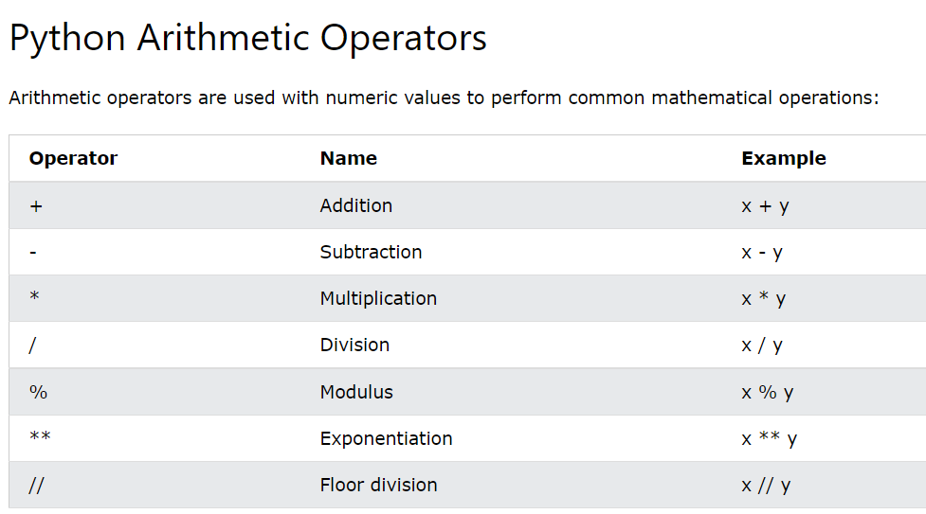

Slide 21
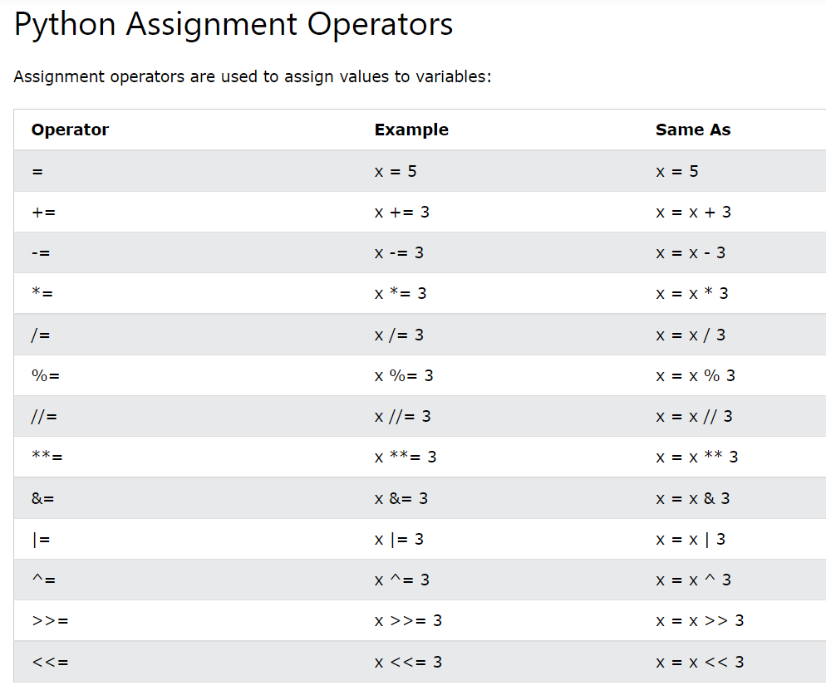

Slide 22
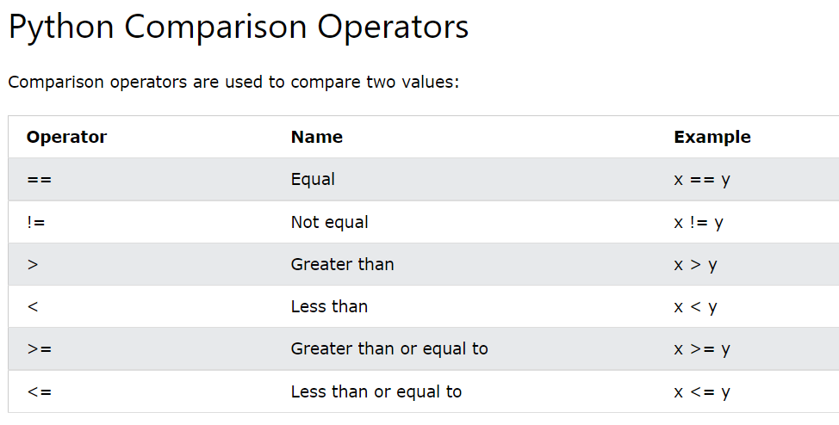

Slide 23
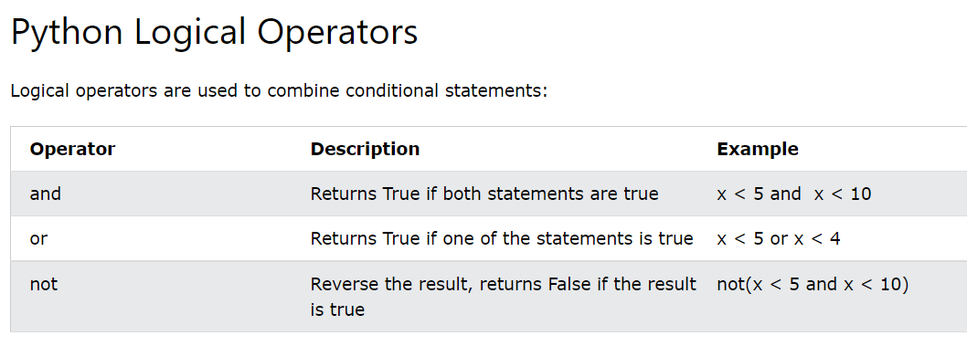

Slide 24
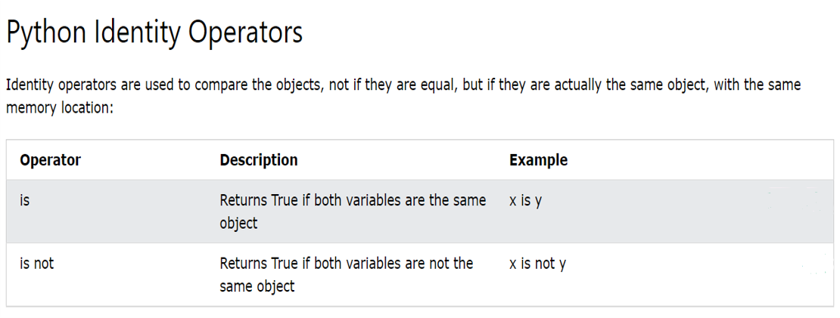

Slide 25
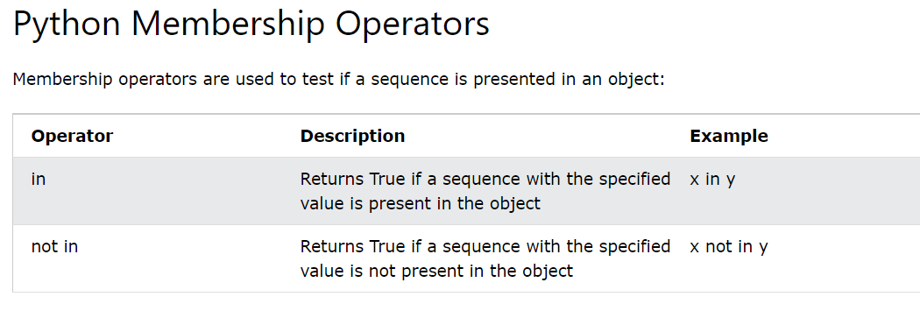

Slide 26
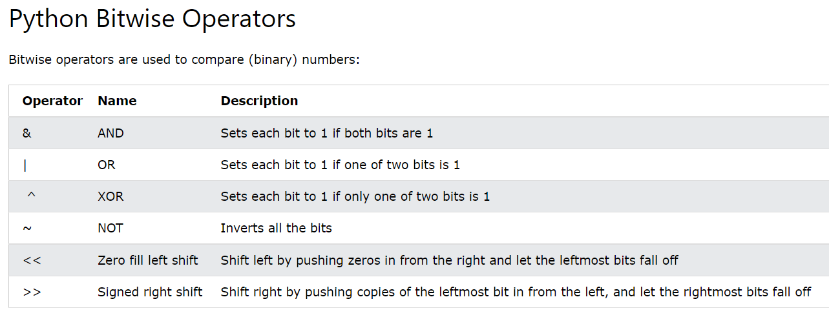

Slide 27
PUNCTUATORS
Punctuators are the symbols that are used in programming languages to organize structures, statements, expressions, etc.
The most common punctuators used in Python are:
‘ “ # \ ( ) [ ] { } , : . = @

Slide 28
SUMMARY - Tokens
TOKENS
Keywords
Identifiers
Literals
Operators
Punctuators

Slide 29
SUMMARY - Literals
LITERALS
String Literals
Numeric Literals
Boolean Literals
Special Literal None
Literal Collections

Slide 30
SUMMARY - Operators
OPERATORS
UNARY OPERATORS
BINARY OPERATORS
Arithmetic operators
Assignment operators
Comparison operators
Logical operators
Identity operators
Membership operators
Bitwise operators

Slide 31
Happy Learning!

